Slide 1

Running Signal
Key insights to stay ahead in the market

Slide 2

October Market Update
Overall Trends in the Freight Market
This section of the presentation will focus on the key trends in the global freight market, including growth rates, market share, and the impact of various factors such as trade policies and economic conditions. We'll examine the market trends of different modalities such as air, sea, and land.
Regional Analysis
This section of the presentation will focus on the regional analysis of the global freight market, examining the trends and challenges in different regions such as Asia-Pacific, North America, Europe, and Middle East and Africa.
Future of the Freight Market
This section of the presentation will conclude by projecting the future of the freight market for the next thirty days, by analyzing various factors that are likely to impact the market such as disruptions, geopolitical risks, shifts in consumer behavior, and technological advancements.

Slide 3

Overall Trends in the Freight Market
Capacity Trends
We will analyze capacity trends in the freight market over the past month, providing charts and callouts to support our analysis.
Rate Trends
We will analyze rate trends in the freight market over the past month, providing charts and callouts to support our analysis.
Volume Trends
We will analyze volume trends in the freight market over the past month, providing charts and callouts to support our analysis.

Slide 4

Capacity Trends
We will analyze the capacity trends in the freight market over the past month and provide charts and callouts to support our analysis. We will also provide our insights on how these trends are likely to impact the market in the next thirty days.

Slide 5
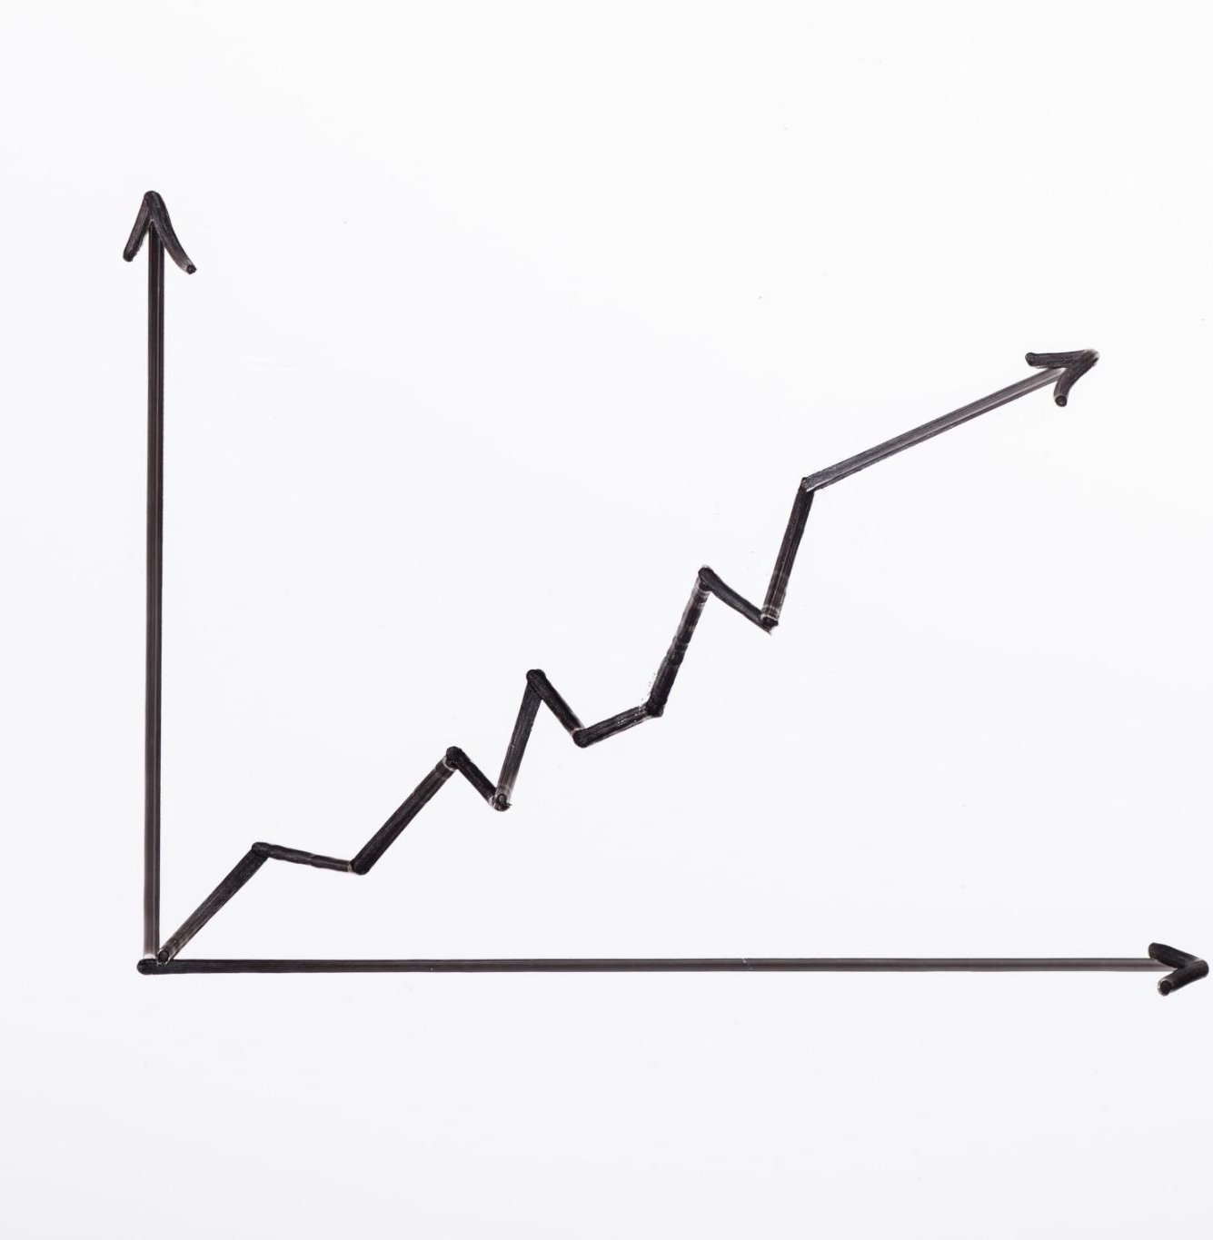
Rate Trends
Rate Trends Analysis
Our analysis of the rate trends in the freight market over the past month shows a significant upward or downward trend, which is likely to impact the market in the next thirty days.
Key Market Drivers
We will identify the key market drivers that led to the current rate trend and discuss how these trends are likely to impact the market in the next thirty days.

Slide 6

Volume Trends
Volume Trends Analysis
This presentation will analyze the volume trends in the freight market over the past month. We will provide our insights on how these trends are likely to impact the market in the next thirty days.
Callouts to Support Analysis
We will provide charts and callouts to support our analysis of the volume trends in the freight market. These charts and callouts will help us to better understand the trends and their impact on the market.

Slide 7

Regional Trends in the Freight Market
Regional Capacity Trends
We will analyze the regional capacity trends in the freight market over the past month using sources like Jason Miller, Freight Forward, and the Wall St Journal logistics Report.
Regional Rate Trends
We will analyze the regional rate trends in the freight market over the past month using sources like Jason Miller, Freight Forward, and the Wall St Journal logistics Report.
Regional Volume Trends
We will analyze the regional volume trends in the freight market over the past month using sources like Jason Miller, Freight Forward, and the Wall St Journal logistics Report.

Slide 8

Regional Capacity Trends
Capacity Trends in Different Regions
We will analyze the capacity trends in different regions of the freight market over the past month, and provide charts and callouts to support our analysis.
Impact of Trends on the Market
We will provide our insights on how these trends are likely to impact the market in the next thirty days.

Slide 9
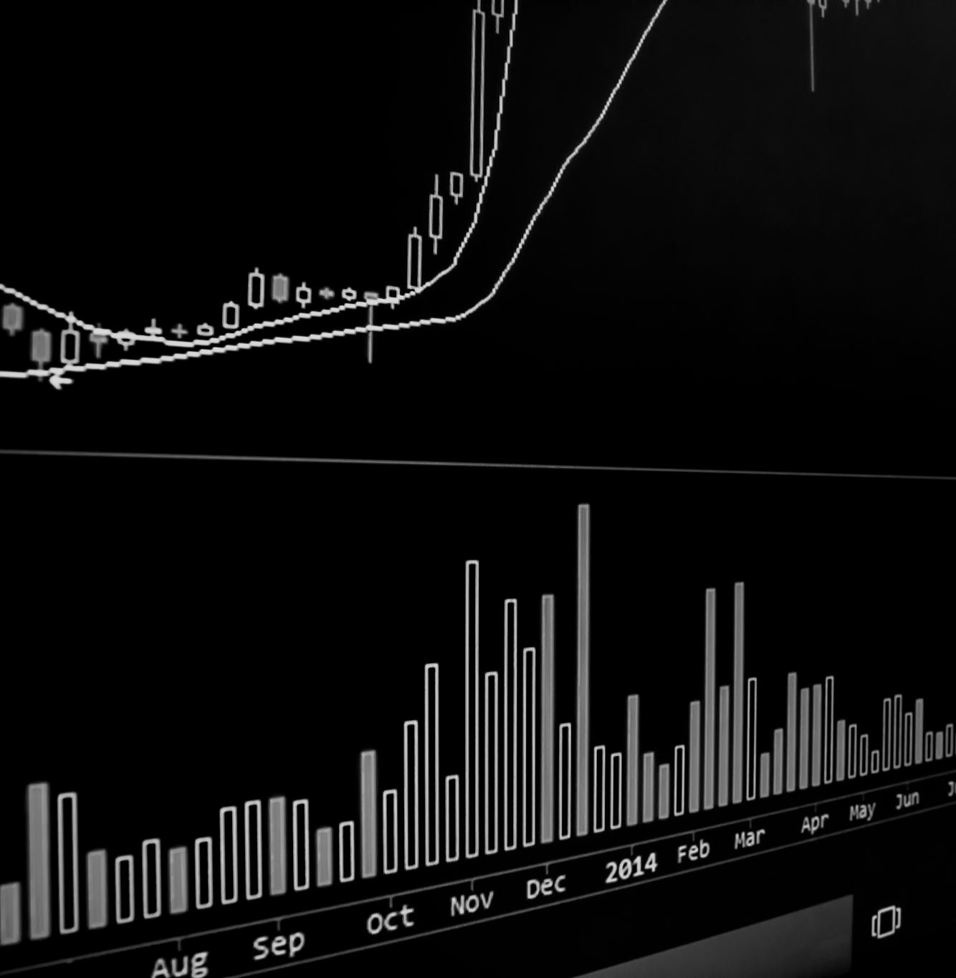
Regional Rate Trends
Rate Trends Analysis
We analyzed the rate trends in different regions of the freight market over the past month and identified key trends that are likely to impact the market in the next thirty days.
Regional Rate Trends
We identified regional rate trends in the freight market over the past month and analyzed their implications for the next thirty days.

Slide 10
Regional Volume Trends
Our analysis focuses on the volume trends in different regions of the freight market over the past month and insights on likely impacts in the next thirty days.

Slide 11

Projecting the Future of the Freight Market
Economic Indicators
Our analysis of the freight market suggests that economic indicators such as GDP and unemployment rates will impact the market in the next 30 days. A growth in GDP will result in increased demand for freight services, while a high unemployment rate may lead to a decrease in demand.
Fuel Prices
Fuel prices are a key factor that will impact the freight market in the next 30 days. An increase in fuel prices will result in higher transportation costs, which may lead to a decrease in demand for freight services.
Natural Disasters
Natural disasters such as hurricanes, floods, and wildfires can have a major impact on the freight market. Our analysis suggests that natural disasters in the next 30 days may lead to disruptions in transportation and delivery, resulting in decreased demand for freight services.

Slide 12

Factors Impacting the Freight Market
Fuel Prices
Fuel prices are a critical factor impacting the freight market. Increases in fuel prices can lead to higher transportation costs and decrease in the overall demand for freight services.
Economic Indicators
Economic indicators such as GDP growth, consumer confidence, and unemployment rate can significantly impact the freight market. A strong economy typically leads to higher demand for freight services.
Natural Disasters
Natural disasters such as hurricanes, floods, and wildfires can disrupt the supply chain and lead to higher transportation costs. Freight companies need to be prepared for such events and have contingency plans in place.
Notes:
We will analyze the factors that are likely to impact the freight market in the next thirty days, such as fuel prices, economic indicators, and natural disasters. We will provide our insights on how these factors are likely to impact the market and make projections based on our analysis.

Slide 13

Conclusion
This presentation provided insights into the major trends, milestones, charts, and callouts from the last month in the Freight Market. Our projections for the next thirty days are based on the information available, and we hope that this presentation has provided you with valuable insights into the Freight Market.
Notes:
In this presentation, we have analyzed the major trends, milestones, charts, and callouts from the last month in the Freight Market, and projected what to expect in the next thirty days. The freight market is constantly changing and evolving. Our projections are based on the information available, and we hope that this presentation has provided you with insights into the Freight Market.

